Slide 1

AI-Powered Smart E-Commerce Product Search and Recommendation Engine Using Hashing Algorithm
CSA0305 – Data Structures
Guided By:
Dr. Uma Priyadarsini P.S,
Professor, SIMATS, Engineering
Presentation By:
G. Santosh Kumar[192524020]
DHIVYADHARSAN M S[192511465]
S. Aravind[192525192]
A.VEERASANTHOSH[192525187]
M. Vaishnav[192524251]

Slide 2



ABSTRACT
The proposed system is designed to improve online shopping by making product searching faster and more efficient. It helps users easily find the products they need from a large product database.
Artificial Intelligence analyzes user preferences, browsing history, and purchase patterns to recommend products that match the user's interests, providing a personalized shopping experience.
The Hashing Algorithm enables quick product retrieval by storing product data efficiently. This reduces search time and improves the overall performance of the system.
The system combines AI and hashing techniques to provide accurate search results and relevant product recommendations, making online shopping easier and more convenient.
The proposed solution improves search speed, recommendation quality, and customer satisfaction. It also helps businesses manage large product databases efficiently and enhance overall sales.

Slide 3

INTRODUCTION
E-commerce platforms contain millions of products, making product search challenging.
AI studies what users search for and buy, then recommends products that match their interests, making shopping faster and more personalized.
Hashing algorithms enable quick product retrieval with efficient search performance.
The system combines AI and hashing to improve search accuracy and user experience.
The proposed solution enhances customer satisfaction, search speed, and recommendation quality.

Slide 4

OBJECTIVES
Design a smart search engine that helps users find product.
Use a hashing algorithm to reduce search time and improve product retrieval performance.
Recommend products based on user preferences, browsing history, and purchase behavior using AI techniques.
Provide accurate search results and relevant recommendations to make online shopping easier and more convenient. Build a scalable and efficient e-commerce system that improves search speed, recommendation quality, and customer satisfaction.

Slide 5
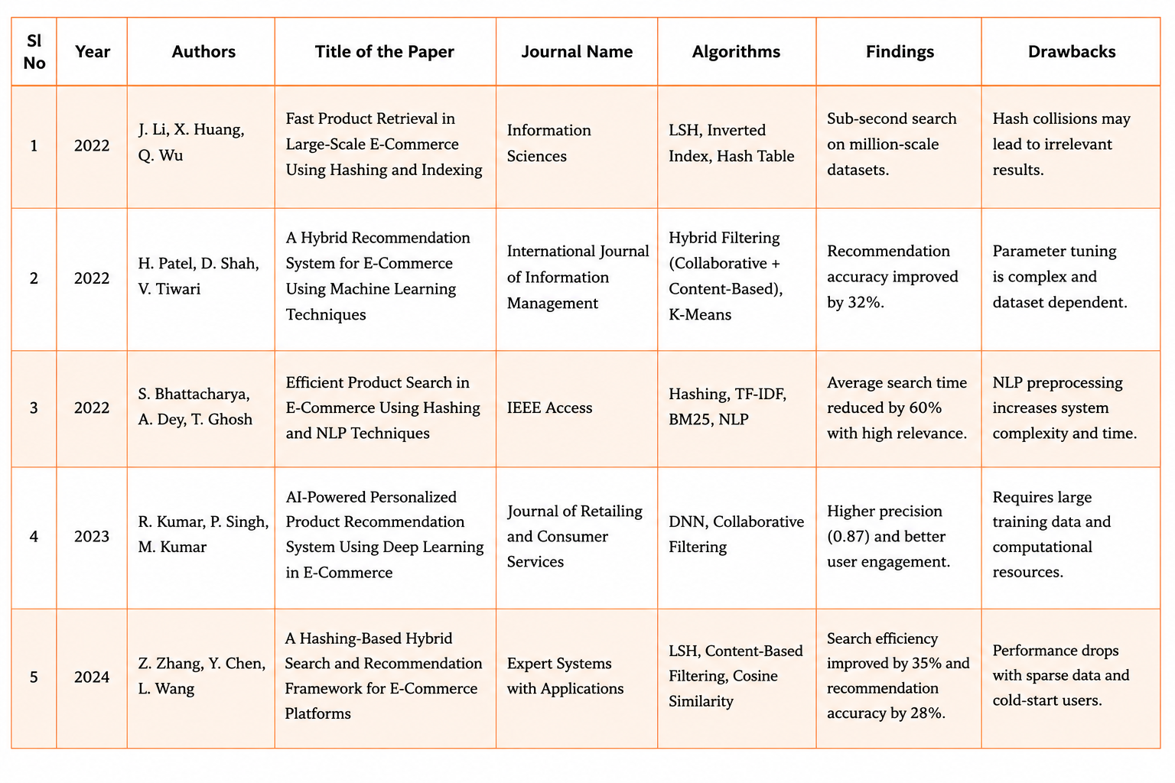
LITERATURE REVIEW

Slide 6
Problem Identification
Traditional search methods take more time to find products from large e-commerce databases.
Users often receive products that do not match their search, making it difficult to find the required item.
Slow searches and inaccurate recommendations reduce customer satisfaction and make online shopping less convenient.
As the number of products and users increases, existing systems struggle to maintain fast search performance and accurate recommendations.

Slide 7
Modules
Module 1: Product Data Management
Module 2: AI Intelligence Module
Module 3: Smart Search Using Hashing
Module 4: AI Recommendation & User Interaction
Module 5: Analytics & Dashboard

Slide 8
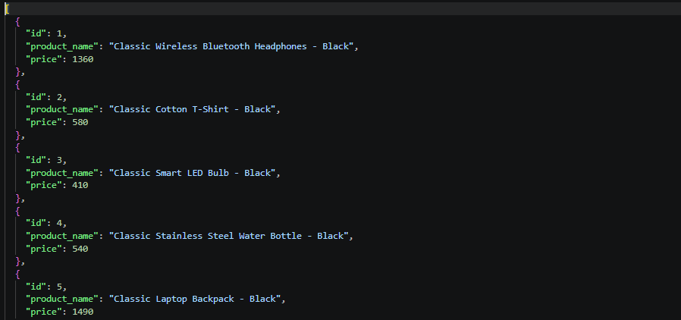
Module 1: Product Data Management
Description
Manages the complete product dataset used by the AI and hashing system. Products are stored with information such as Product ID, Product Name, Category, Price, and other attributes.
Techniques Used:
JSON-based product storage
Data preprocessing
Data validation
CRUD operations
Structured product representation
Features:
Add and manage products
Unique Product ID
Product name and category management
Price management
Product data retrieval
Outcome: Creates a clean, structured product database that can be efficiently processed by the AI and hashing modules.

Slide 9
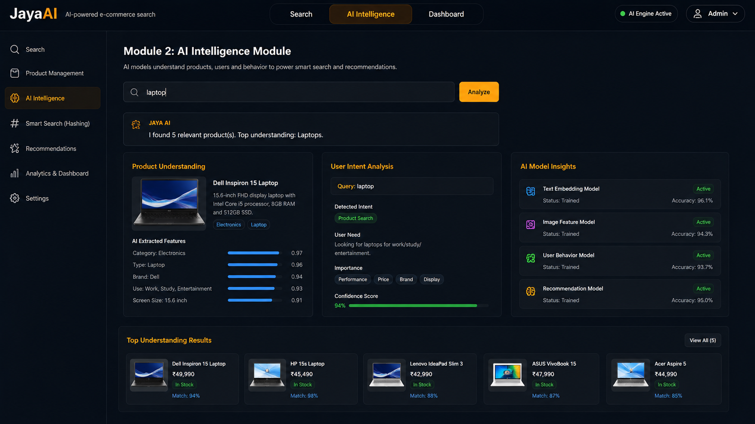
Module 2: AI Intelligence Module
Description: This is the AI layer of the project. It understands the user's natural-language query and determines what
product or information the user is looking for.
Techniques Used:
Artificial Intelligence
NLP (Natural Language Processing)
Text preprocessing
Semantic/query understanding
AI-based intent identification
Features:
Understands natural-language queries
Identifies product-related keywords
Understands user intent
Connects user queries with product data
Provides intelligent responses
Outcome: Allows users to search and interact with the system using normal human language instead of requiring exact product names or IDs.

Slide 10
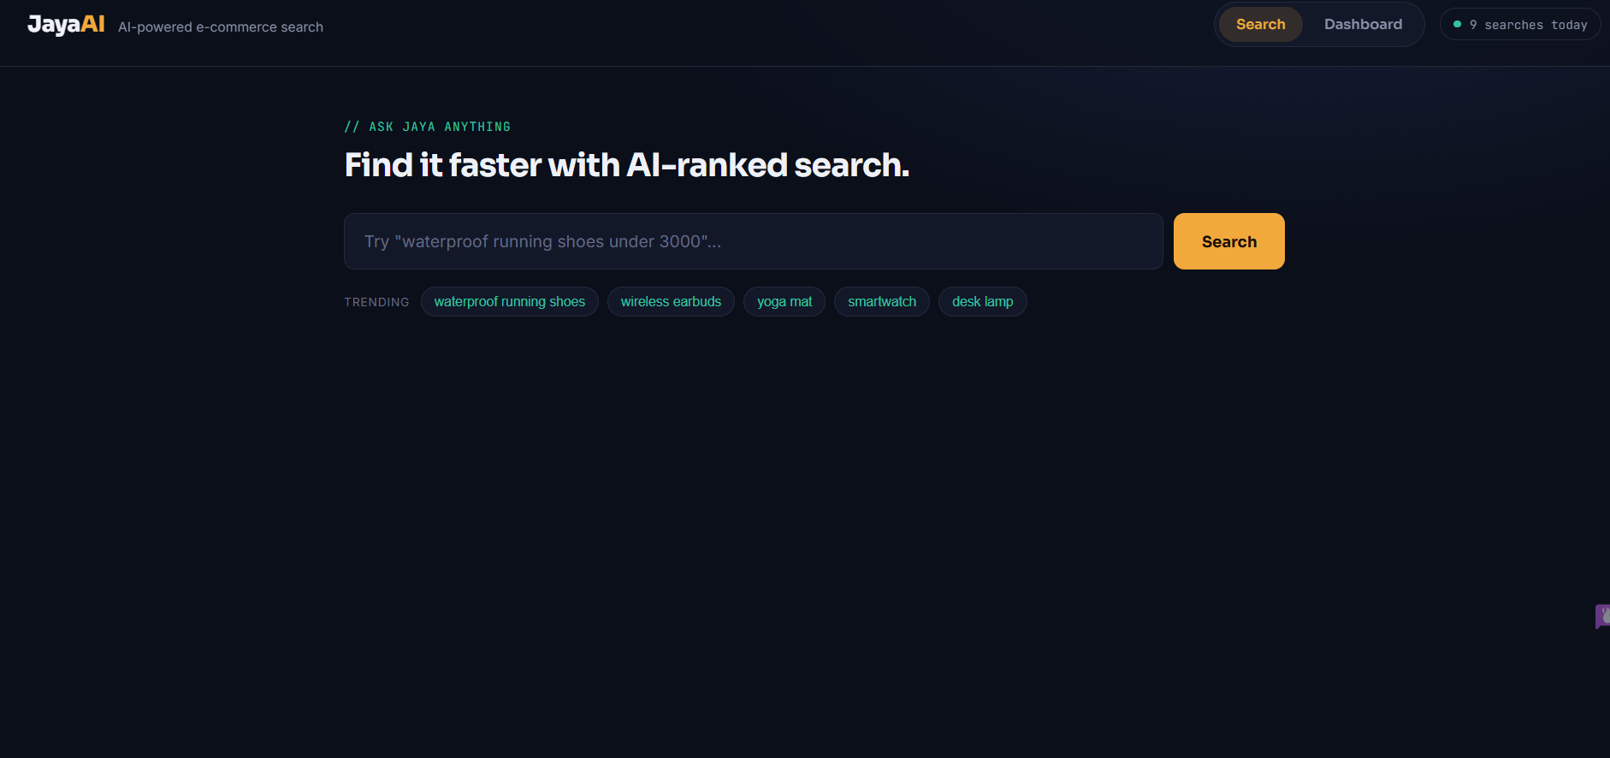
Module 3: Smart Search Using Hashing
Description: This is the core technical component of our project. Hashing is used to create a fast mapping between product
information and product records. The AI interprets the query first, then the hashing system helps retrieve the
relevant product efficiently.
Techniques Used:
Hash functions
Hash tables
Key-value mapping
Product ID indexing
Keyword-based hashing
Fast lookup
Features:
Fast product retrieval
Product ID lookup
Keyword/product-name lookup
Efficient indexing
Reduced search time
AI + hashing integration
Outcome: Provides fast and efficient product searching. Hash-table lookup has an average O(1) time complexity when searching by an appropriate hashed key.

Slide 11
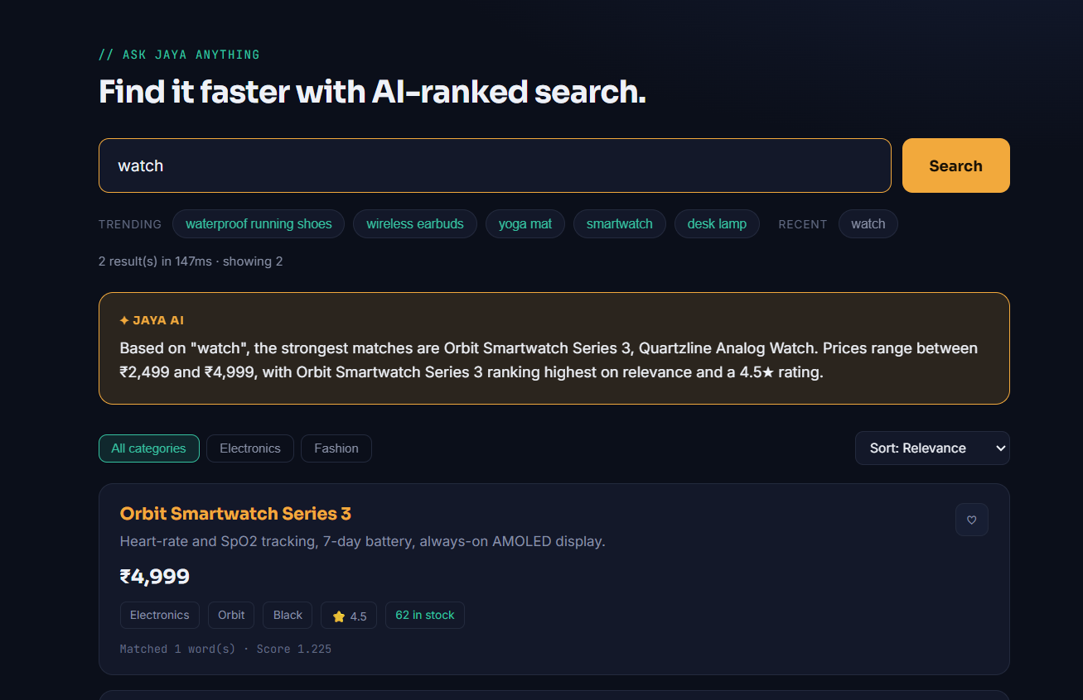
Module 4: AI Recommendation & User Interaction
Description: Uses the user's search queries and interactions with products to provide AI-based product
recommendations.
Techniques Used:
Recommendation algorithms
User preference analysis
Content-based recommendation
NLP
Query/product similarity
Features:
Related product suggestions
Personalized recommendations
User interaction
Query-based recommendations
Product similarity
Outcome: Improves the shopping experience by providing relevant products based on the user's query and interaction patterns.

Slide 12
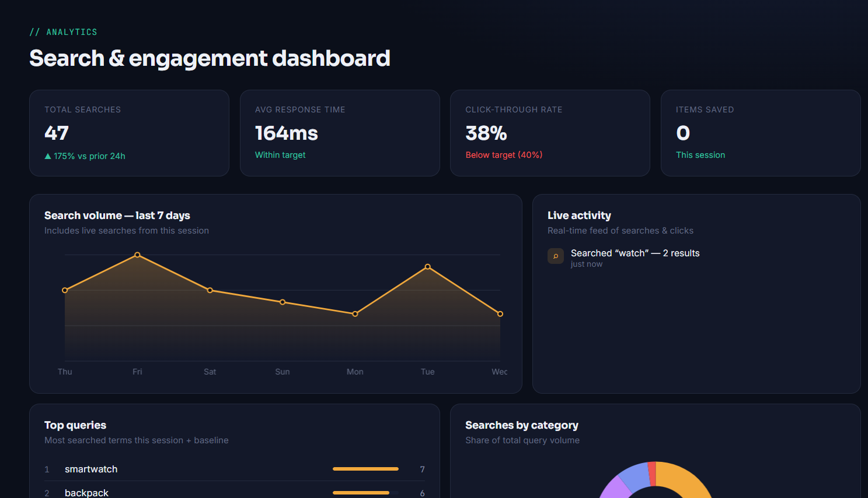
Module 5: Analytics & Dashboard
Description: Monitors the performance of the AI and hashing-based search system and presents important information
through a dashboard.
Techniques Used:
Data analytics
Search-performance analysis
Statistical analysis
Data visualization
KPI tracking
Features:
Number of searches
Most searched products
AI query statistics
Search response performance
Recommendation statistics
Product statistics
Graphs and charts
Outcome: Provides clear performance insights into the AI search, hashing system, product usage, and recommendations.

Slide 13
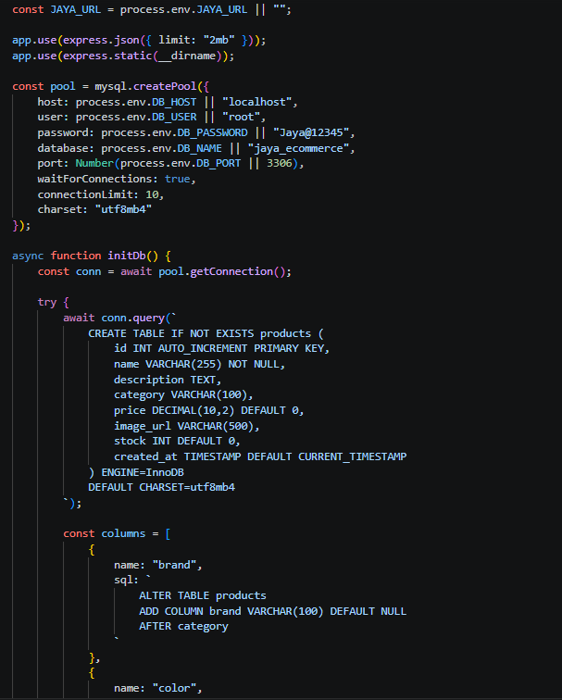
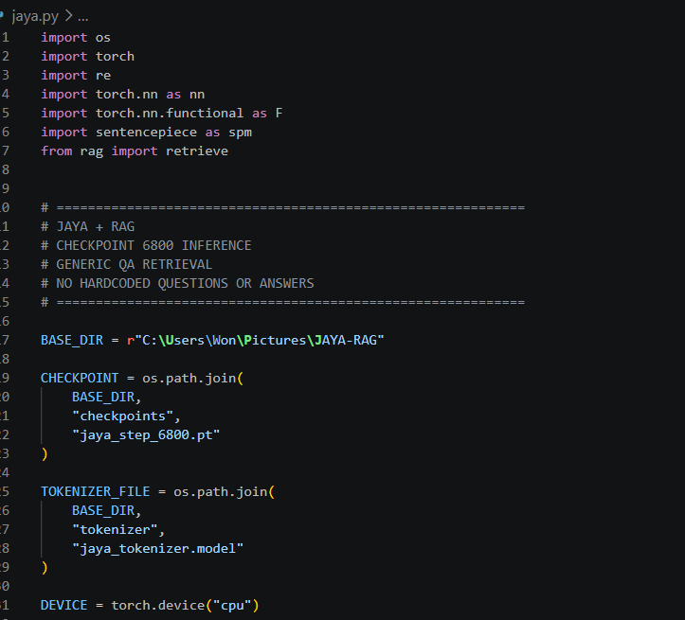
CODE

Slide 14
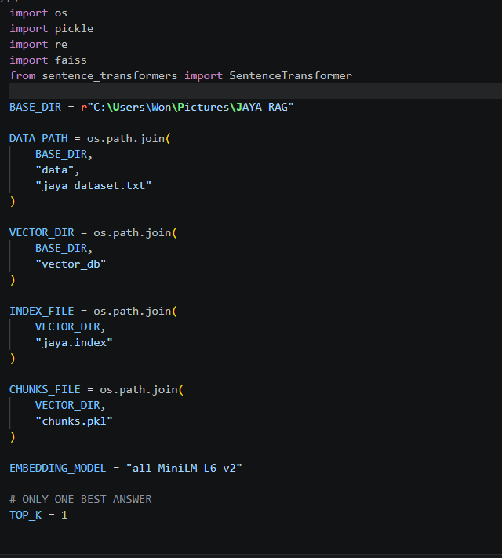
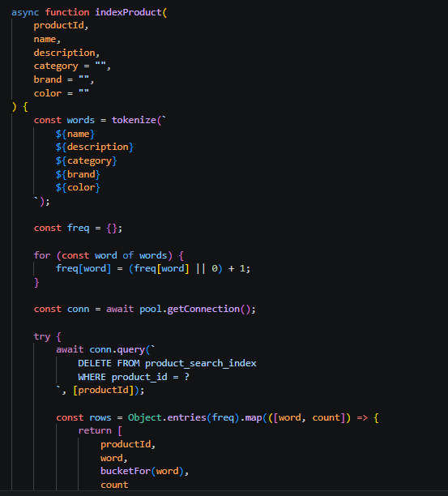
CODE

Slide 15
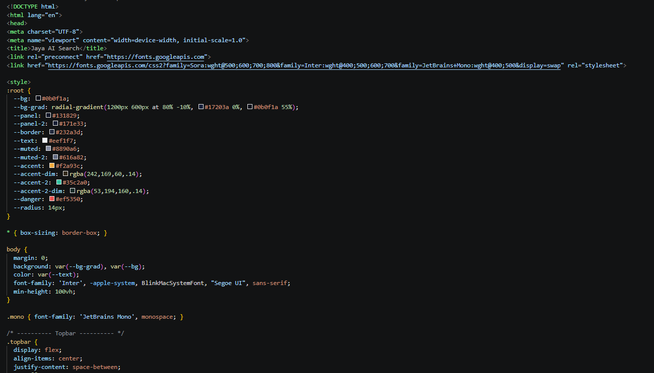
CODE

Slide 16
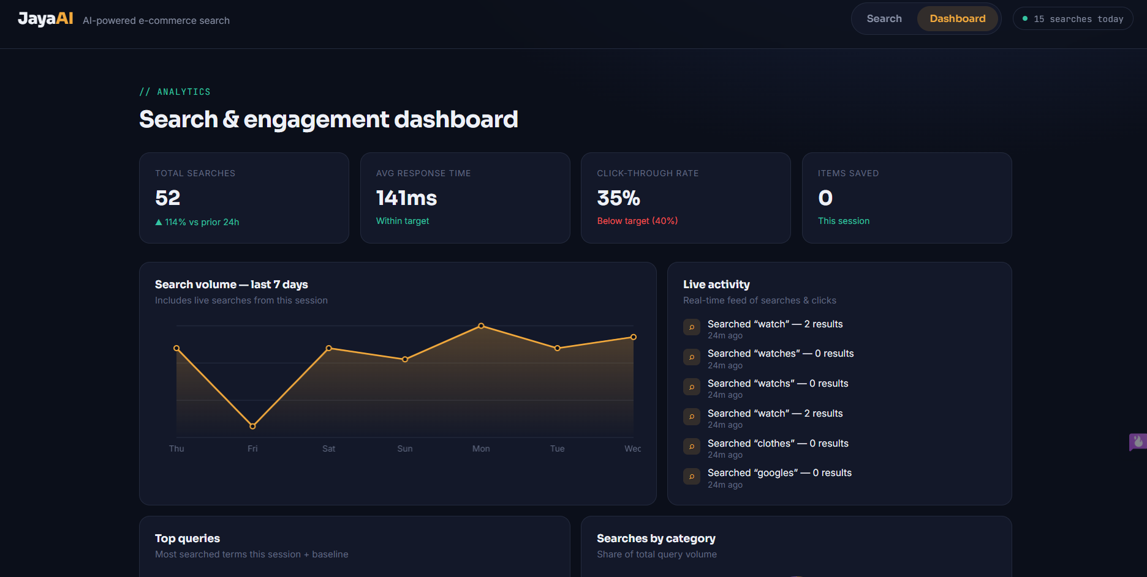
OUTPUT

Slide 17
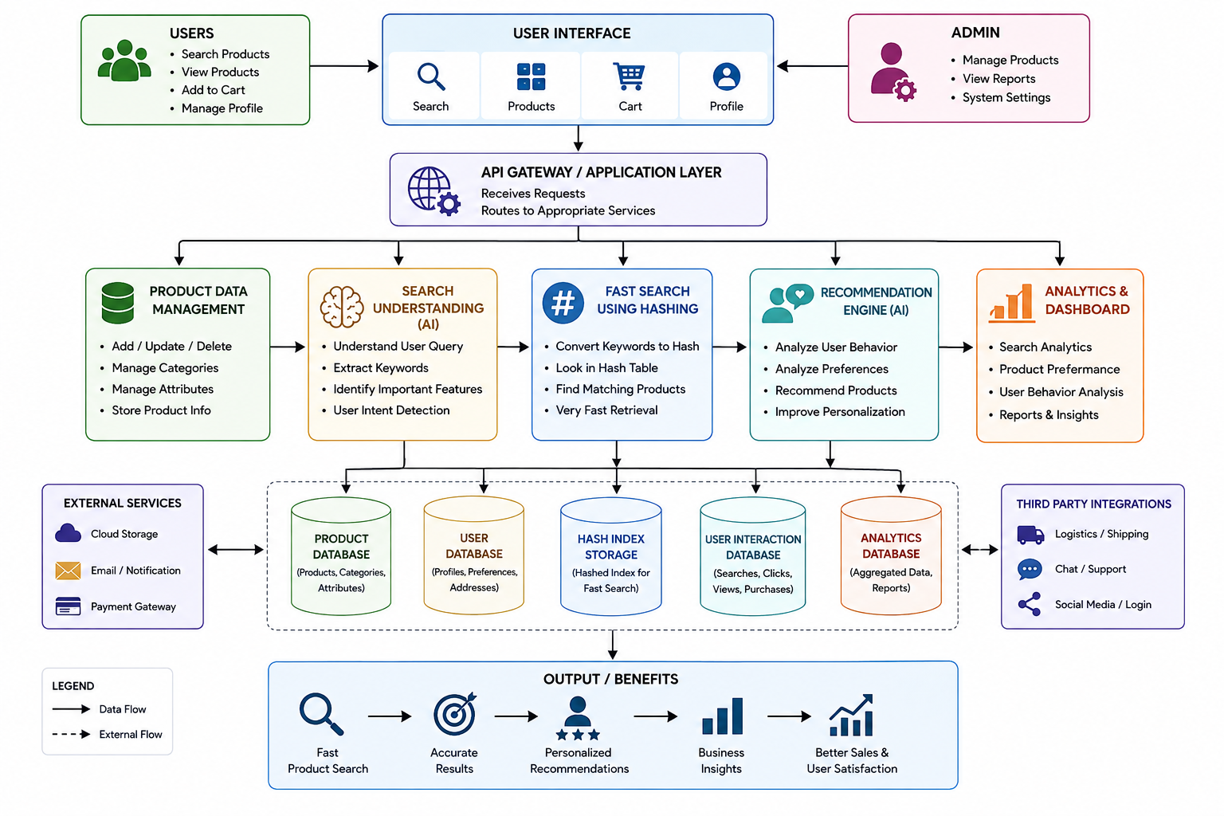
SYSTEM ARCHITECTURE

Slide 18
SOLUTION DESIGN AND IMPLEMENTATION
Product Data Management
Collect, validate, update, and store product details such as name, category, price, and attributes.
AI Intelligence
Process product information and user queries to identify important keywords, features, and search intent.
Smart Search Using Hashing
Convert keywords into hash values and use a hash table for fast and efficient product retrieval.
AI Recommendation & User Interaction
Analyze user searches, clicks, views, and preferences to provide personalized product recommendations.
Analytics & Dashboard
Monitor searches, product performance, user behavior, and recommendations through an admin dashboard for better decision-making.

Slide 19
RESULTS AND RECOMMENDATION
Faster Product Search
Hashing enables quick retrieval of products, reducing search time and improving system performance.
Relevant Search Results
AI analyzes user queries and product features to provide more accurate and relevant products.
Personalized Recommendations
User interactions such as searches, clicks, and views are used to suggest products based on user preferences.
Improved User Experience
The combination of fast search and personalized recommendations makes product discovery easier and more efficient.
Future Recommendation
The system can be enhanced with advanced AI models, real-time analytics, voice search, and personalized recommendations based on purchase history.

Slide 20
FUTURE SCOPE
Real-Time Learning The system can continuously learn from user searches, clicks, and purchases to improve
search accuracy and recommendations.
Voice-Based Search Voice search can be integrated to allow users to find products using natural voice
commands.
Advanced Personalization The system can provide highly personalized recommendations based on individual user
preferences and behavior.
Scalable Product Database The system can be expanded to support millions of products and users while maintaining
fast search performance.
Multilingual Support The system can support multiple languages to make product search and recommendations
accessible to more users.

Slide 21
CONCLUSION
Integrated System
Combines product management, AI processing, hashing-based search, recommendations, and analytics in one platform.
Accurate Product Discovery
Helps users find suitable products based on keywords, product features, and search intent.
Reduced Search Complexity
Hash-based indexing reduces unnecessary comparisons and improves product lookup efficiency.
Data-Driven Decisions
Analytics provides useful insights into customer behavior and product demand.
Future-Ready Platform
The system can be extended with real-time learning, advanced personalization, and additional e-commerce features.

Slide 22
REFERENCE
Cormen, Thomas H., Charles E. Leiserson, Ronald L. Rivest, and Clifford Stein. Introduction to Algorithms. MIT Press.
Russell, Stuart, and Peter Norvig. Artificial Intelligence: A Modern Approach. Pearson.
Aggarwal, Charu C. Recommender Systems: The Textbook. Springer, 2016.
Manning, Christopher D., Prabhakar Raghavan, and Hinrich Schütze. Introduction to Information Retrieval. Cambridge University Press, 2008.
Koren, Yehuda, Robert Bell, and Chris Volinsky. "Matrix Factorization Techniques for Recommender Systems." Computer 42, no. 8 (2009): 30-37.
Han, Jiawei, Micheline Kamber, and Jian Pei. Data Mining: Concepts and Techniques. Morgan Kaufmann.
Leskovec, Jure, Anand Rajaraman, and Jeffrey D. Ullman. Mining of Massive Datasets. Cambridge University Press.

Slide 23
THANK YOU

